Slide 1

Session 4
Linear Programming – Transportation
Big Data and Analytics
Topic 4:
Analytics Engine for Big Data- Apache Spark
We will wait for 5 to 10 mins for everyone to join

Slide 2

Recap
Linear Programming – Transportation
What we discussed last week?

Slide 3
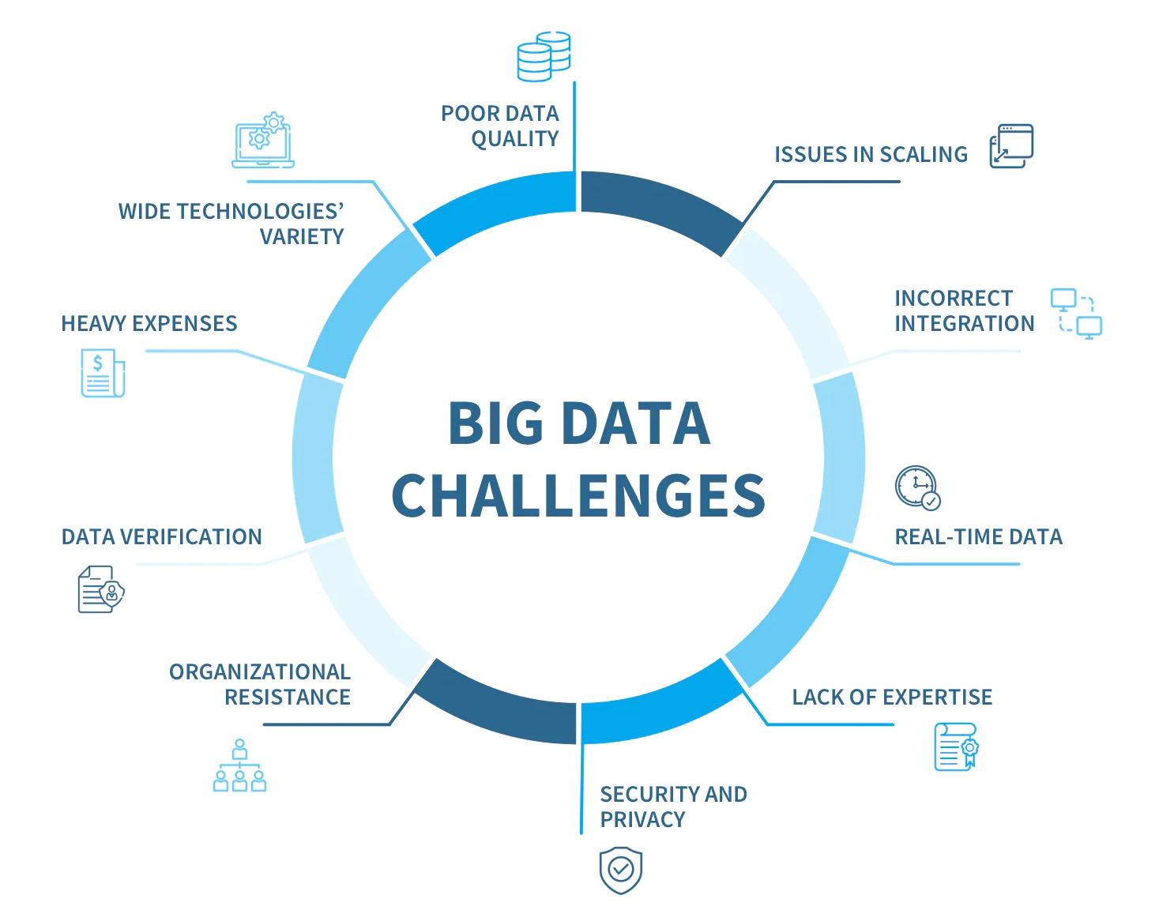
Recap From Last Week
Linear Programming – Transportation
Top 8 Challenges in Big Data:
Managing massive amounts of data. It's in the name—big data is big. ...
Integrating data from multiple sources. ...
Ensuring data quality. ...
Keeping data secure. ...
Selecting the right big data tools. ...
Scaling systems and costs efficiently. ...
Lack of skilled data professionals. ...
Organisational resistance.
Notes:
Finding Staff: the number of data scientists and Big Data analysts continues to grow, there is still a lack of people to fill all the positions in the Big Data research industry. The typical Big Data expert has gained experience with tool implementation and has an understanding of how to organize the data to best research it. Data scientists and Big Data analysts should be familiar with traditional relational database tools, as well as in-memory analytics, NoSQL Data Management frameworks, and Hadoop ecosystems.
Bringing in the Data: The issues involved with accessing data coming from an extensive range of sources is also a challenge. The skills needed to navigate the extraction processes are necessary for the goal of analysing and processing Big Data.
Synchronization: Data coming from a wide range of sources uses different schedules and rates, and can quickly become desynchronized from the originating system. Data synchronization provides consistency in systems and continually updates to maintain that consistency. In traditional Data Management systems, the process of data extraction, migration, and transformation all promote desynchronization.
Data Management Tools: Incompatibility between Big Data Management tools can cause problems. They can be incompatible NoSQL approaches — hierarchical object representation and the key-value storage provide two good examples. The range of NoSQL tools has caused some confusion regarding the compatibility of different approaches. Selecting the appropriate tools for a highly functional data integration system requires forethought. Small organizations that are planning to start data warehousing face a decision about the tools they will be using.
Choosing a Strategy: Big Data Integration often begins with a simple need to share information. This is often followed by an interest in breaking down the “data silos” for purposes of analysis. Businesses will often leap from one project to another without an organizational plan. To meet goals that are sometimes contradictory, and include security and compliance needs, a true data integration strategy should be developed.

Slide 4
Recap From Last Week
Linear Programming – Transportation
Data Pipeline:
A series of automated data processing steps and tools that:
transport and refine raw data
from source systems to analytics databases or operational systems.
Data pipelines enable:
data transformation,
enrichment, and
movement to ensure that data is readily available,
trustworthy, and
in the right format for analysis.

Slide 5
Recap From Last Week
Linear Programming – Transportation
A breakdown of common tools used in different parts of a data pipeline
Data Ingestion (Moving data from various sources into the pipeline)
Data Processing (Transforming and processing the data)
Data Storage (Store Processed data)
Data Analysis & Computation
Data Orchestration & Workflow Management (Managing and automating workflows)
Data Consumption (Visualization & Dashboarding)
Data Monitoring & Management (Ensuring data quality, monitoring data flow)
Notes:
Source of image: Upsolver

Slide 6
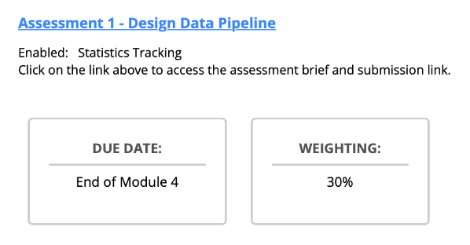
Assignment due this week
Linear Programming – Transportation

Slide 7
Case Study
Linear Programming – Transportation
CityFresh Markets is an emerging online platform based in Brisbane, Australia, focusing on delivering fresh farm produce and organic food products directly to households. The portal sees a steady traffic of around 50,000 health-conscious visitors every month. When it comes to completing an order, shoppers are given three alternatives: 1) signing in using an existing membership; 2) initializing a fresh membership if they're new to the platform; or 3) opting for a one-time purchase without the need for membership.
The account details of shoppers are fragmented across two internal systems - one managed by the customer relations team and the other by the health and nutrition outreach team. The procurement department, on the other hand, oversees the details of orders and supply chain data. In tandem, the digital operations unit is responsible for the platform's user experience and stability.
Bi-monthly, CityFresh Markets rolls out an e-magazine that encompasses articles about healthy living, showcases farm stories, highlights fresh arrivals, and offers exclusive discounts. This digital magazine is both displayed on the platform and dispatched to their community of registered shoppers. It's essential to note that as of now, the platform follows a one-size-fits-all model, implying every user, regardless, or preferences, views the same content.
In the past few months, CityFresh Markets hof past interactions, locationas encountered an unexpected plateau in its growth trajectory. Even with their unique selling proposition of farm-fresh products, the metrics reflecting site engagement and conversion rates (the fraction of users who move from browsing to purchasing) are not as promising as projected.
To counter this challenge and infuse momentum into sales, the top brass at CityFresh Markets envisions transitioning to a data-centric operational model. They're eager to explore the domain of data analytics to curate bespoke user journeys, which might include features like health-based product suggestions, personalized discount strategies, and insights into buying patterns.
Embarking on this data-centric journey necessitates the creation of an adept data pipeline. The primary objective of this pipeline would be to adeptly collate data from diverse touchpoints, harmonize it, and then deposit it into a 'data repository'. This centralized hub should facilitate seamless access for strategists, leaders, and data professionals.
Notes:
Internal Data Sources:
Customer Relations System: Contains customer profiles, preferences, feedback, and complaint data.
Health and Nutrition Outreach System: Records of customer interactions.
Procurement System: Order details, supply chain data, inventory, and supplier details.
Digital Operations: Website analytics, clickstreams, user session logs, and cart abandonment data.
External Data Sources:
Social Media Channels: Feedback, reviews, likes, shares, mentions, and engagement metrics.
Third-Party Review Sites: Customer reviews and ratings.
Weather Data Services: For assessing the influence of weather on product demand, especially for seasonal farm products.
Market Research Firms: Trends in organic and farm-fresh product consumption.
Campaigns, webinar and workshops: Records of health campaigns, nutrition webinars, and workshops

Slide 8
Case Study
Linear Programming – Transportation
The information you can provide about data characteristics:
Type of Data: Whether the data is structured (like databases with defined fields), semi-structured (like JSON or XML files), or unstructured (like plain text or images).
Volume: How much data is produced and stored. For example, clickstream data from a website might be generated at a rate of gigabytes per day, while a sales database might only be a few megabytes.
Velocity: The speed at which new data is generated and needs to be processed. Real-time data, such as website interactions, has a high velocity.
Variability: How consistent is the data format? If a data source frequently changes its format, it has high variability.
Fields/Attributes: What are the specific pieces of information contained in the data? For instance, transactional data might have fields like TransactionID, UserID, ProductID, Timestamp, and Amount.
Format: How is the data formatted? Is it in CSV files, relational databases, logs, JSON files, etc.?
Quality: The accuracy, completeness, reliability, and consistency of the data. High-quality data has fewer missing values, errors, or inconsistencies.
Source: Where is the data coming from? Is it internal (like sales databases) or external (like social media analytics)?

Slide 9
Case Study
Linear Programming – Transportation
Example of external data: Market Research:
Farm Reports:
Source: Typically generated by farmers or agricultural experts overseeing the operations of a farm.
Content: Contains information about crop yields, soil health, usage of fertilizers and pesticides, machinery and equipment status, livestock health (if applicable), and other farming activities.
Structure: Can be both structured (numeric data about yields, equipment usage, etc.) and unstructured (observations, notes about crop health or any anomalies).
Frequency: Might be generated after specific farming cycles, seasons, or at regular intervals (monthly, quarterly).
Data Types:
Structured: Quantitative metrics like crop yield (in tons or other units), amount of fertilizer used (in kilograms or liters), number of equipment pieces used, etc.
Unstructured: Observations or notes about pest infestations, comments about soil health, remarks about any unusual weather conditions affecting crops, etc.
Relevance: Vital for understanding the agricultural output and any challenges faced during farming. It can influence decisions about what crops to prioritise, when to harvest, and how to deal with pests or diseases.
Assumptions: It's assumed that farm reports are provided immediately after the end of each farming cycle or season, allowing for timely decision-making. If receiving reports from multiple farms or suppliers, it's assumed that they all follow a standardized format or structure, aiding in easy comparison and aggregation.
2. Market Trend Data:
Source: Often generated by market research firms, industry experts, or gathered through surveys and data analytics tools.
Content: Contains insights about the popularity of certain products, changes in consumer preferences, market growth or decline rates, competitive analysis, and potential opportunities or threats.
Structure: Usually structured (data points, percentages, growth rates) but can also have unstructured elements (analyst observations, qualitative feedback from surveys).
Frequency: Can be updated periodically, such as monthly, quarterly, or annually. Special reports might be generated after significant market events.
Data Types:
Structured: Numeric data like market growth rate (%), sales volume of specific products, market share (%), etc.
Unstructured: Qualitative feedback from consumers, expert opinions, and narrative descriptions of market dynamics.
Relevance: Essential for strategic decision-making. Helps businesses understand where they stand in the market, what products or services are gaining traction, and how to position themselves against competitors.

Slide 10
Case Study
Linear Programming – Transportation
Big Data Challenges:
Data Volume: With both online transactions and potential in-person events like health workshops, CityFresh Markets is accumulating vast amounts of customer, transaction, and engagement data daily. Managing this magnitude, especially from diverse sources like the customer relations system, procurement logs, and digital operations, poses a significant challenge.
Data Variety: The platform's digital operations might produce structured logs, while feedback from health campaigns could be unstructured text. The mix of structured, semi-structured (like JSON from web interactions), and unstructured data (like customer feedback or reviews) requires versatile processing solutions.
Data Velocity: Real-time analytics from website interactions, combined with transactional data and feedback from bi-monthly e-magazines, means data is pouring in at high speeds. The company must be equipped to process this information promptly to make informed decisions.
Data Veracity: Ensuring that feedback from health campaigns is genuine and not manipulated, verifying the authenticity of …...
Data Integration: Merging data from the customer relations system with that of the health and nutrition outreach program, without causing data duplication or loss, is essential to …….
Data Privacy and Security: Given the nature of products – fresh produce and organic foods – understanding customer dietary habits and preferences can be sensitive. Additionally, protecting transactional data and personal customer information from potential breaches is paramount in maintaining trust and compliance with data protection regulations.

Slide 11
Case Study
Linear Programming – Transportation
Recommended Data pipeline:
Data Ingestion
Extract data from farm management systems, health and nutrition outreach records, procurement systems, and digital operations logs.
Utilise sensors, IoT devices, or manual data logging mechanisms from the farm fields to capture real-time data on crop health, soil conditions, and weather patterns.
Ingest data from external sources like weather forecast services, agricultural research bodies, and any collaborations with universities or agri-tech companies.
Data Transformation
Process data to ensure uniformity, especially if data is coming from diverse farm sources or different farming methodologies.
Handle missing data, outliers, or inconsistencies often found in sensor data or manual logs.
Integrate insights from market trend data to associate with actual farm outputs, leading to better demand-supply matching.
Data Storage
Use a hybrid storage system that combines relational databases for structured data (like farm reports) and NoSQL or data lakes for semi-structured and unstructured data (like sensor logs or images).
Leverage cloud platforms like AWS, GCP, or Azure for scalability, especially during harvesting seasons when data influx might be higher.
Maintain backup mechanisms considering the critical nature of the data.
Data Analytics
Implement frameworks such as Apache Spark for analytics that combine farm operations with market trends.
Apply advanced analytics for soil health prediction, crop yield forecasting, and pest/disease prediction using AI/ML models.
Integrate insights from health campaigns and nutrition webinars to align crop production with ongoing health trends.
Data Visualisation and Reporting
Utilize domain-specific visualization tools that cater to agriculture, like AgStudio or FarmLogs, along with mainstream tools like Tableau or Power BI.
Design dashboards that provide insights into farm productivity, crop health, inventory status, and correlation with market trends.
Make the data accessible to various stakeholders - from farm managers and field workers to supply chain personnel and market strategists.

Slide 12
Case Study
Linear Programming – Transportation
Sample of Recommended Tools example for the first 2 stage of data pipeline:
Data Ingestion (Moving data from various sources into the pipeline)
Farm Reports: Apache NiFi or Talend:
Reason: Both are versatile data integration tools. They support multiple data sources and formats, ensuring easy and efficient data ingestion. They provide out-of-the-box connectors and a visual interface that simplifies the design and maintenance of data flows.
Market Trend Data: Web Scrapers (Beautiful Soup, Scrapy):
Reason: Essential for extracting data from websites, especially if there's no direct API access. These libraries are well-documented, supported, and can handle complex web scraping tasks.
Data Processing (Transforming and processing the data)
Apache Kafka:
Reason: It's an industry-standard for handling real-time data streams. Kafka ensures data is ingested in real-time and can act as a buffer to manage data velocity and ensure no data loss.
Apache Spark:
Reason: Known for in-memory computation, Spark can process vast amounts of data quickly. Its resilience and distributed nature make it ideal for big data transformations, aggregations, and computations.

Slide 13
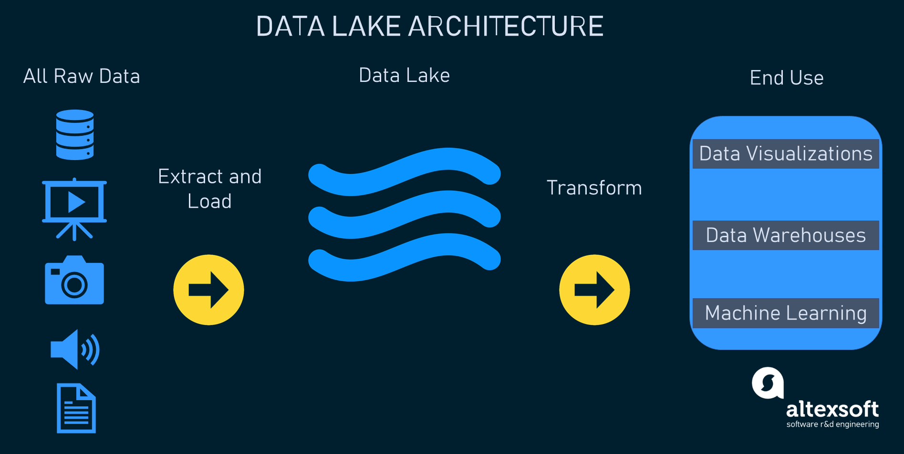
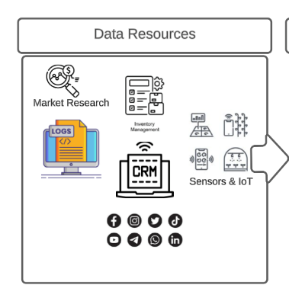
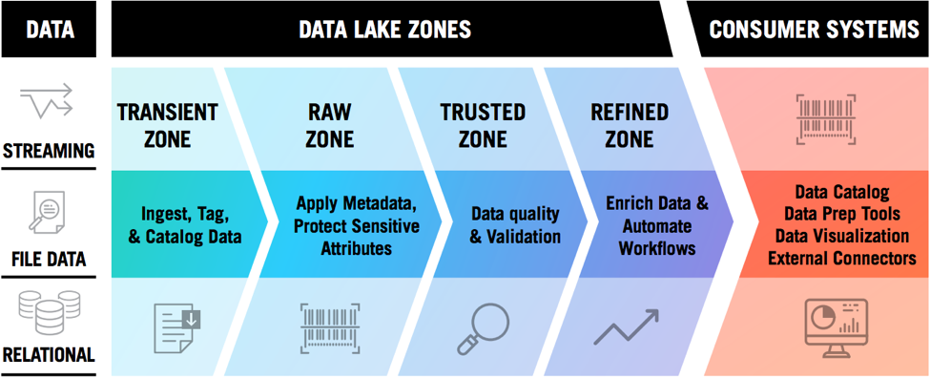
Case Study
Linear Programming – Transportation
Data pipeline Schema Sample:
https://www.altexsoft.com/blog/data-lakehouse/
Source:https://www.zaloni.com/resources/blogs/what-defines-an-effective-data-lake/

Slide 14
Apache Spark
Linear Programming – Transportation
Apache Spark:
Apache Spark is a fast, in-memory data processing engine with elegant and expressive development APIs which enable data workers to efficiently execute streaming, machine learning, or SQL workloads.
why many organisations and individuals choose to use Apache Spark:
Performance: In-memory Computing, Optimised Execution Plans
Flexibility: Multiple Languages, Varied Data Sources
Unified Platform
Fault Tolerance
Scalability
Community and Ecosystem
Advanced Analytics
Stream and Batch Processing in One Framework
Ease of Use
Integration with Big Data Tools
Dynamic and Growing Ecosystem
Notes:
Performance:
In-memory Computing: Spark utilizes in-memory processing, which means it stores data in RAM instead of relying on disk-based storage. This leads to faster data access and computation speeds.
Optimized Execution Plans: With Catalyst optimizer, Spark creates efficient execution plans for operations, further speeding up tasks.
Flexibility:
Multiple Languages: Spark provides native APIs in Java, Scala, Python, and R. This broadens its appeal to developers from different programming backgrounds.
Varied Data Sources: It supports various data sources including HDFS, Cassandra, HBase, Amazon S3, and many more.
Unified Platform:
Spark offers built-in libraries for various tasks. This includes Spark SQL for SQL and structured data processing, MLlib for machine learning, GraphX for graph processing, and Spark Streaming for real-time data processing. This unification means that developers can use a single framework to handle varied processing tasks, simplifying the development process.
Fault Tolerance:
Through the lineage information of RDDs (and other data structures), if any partition of an RDD is lost, Spark can recompute it using its lineage. This ensures that data is not lost and computations can still proceed in the case of node failures.
Scalability:
Spark can scale from a single machine to thousands of nodes, making it suitable for tasks ranging from local data processing on a laptop to processing petabytes of data on a large cluster.
Community and Ecosystem:
Spark has a vibrant and active community. This means extensive documentation, regular updates, and a plethora of resources for new users.
Advanced Analytics:
Apart from basic data processing, Spark offers built-in libraries for more advanced analytics tasks. This includes machine learning (with MLlib) and graph algorithms (with GraphX).
Stream and Batch Processing in One Framework:
Unlike many other systems, Spark offers both batch processing and real-time stream processing in the same framework. This means you can use the same code base for both batch and stream processing tasks, simplifying development and maintenance.
Ease of Use:
High-level APIs and rich built-in functions make it easier to process data without getting into the intricacies of distributed computing.
Integration with Big Data Tools:
Spark integrates well with popular big data frameworks like Hadoop. For instance, it can use HDFS for distributed storage and run on YARN, the resource manager of Hadoop.
Dynamic and Growing Ecosystem:
Spark continues to evolve with contributions from a large community, making it a dynamic platform with continuous improvements and additions.
Considering these advantages, Apache Spark is often the tool of choice for big data processing, especially for organizations that require fast processing, ease of use, and the flexibility to handle diverse big data tasks with a unified platform. However, as with any technology, it's crucial to evaluate if Spark aligns with the specific requirements and infrastructure of the project at hand.

Slide 15
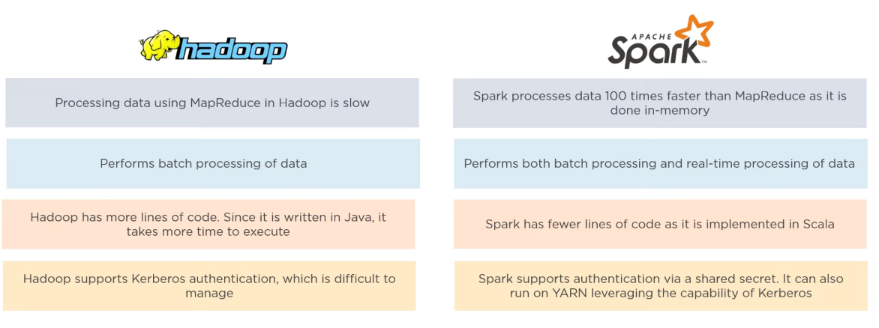
Comparison between Hadoop and Spark
Linear Programming – Transportation
Notes:
From What Is Apache Spark? | Apache Spark Tutorial | Apache Spark For Beginners | Simplilearn – YouTube
https://www.youtube.com/watch?v=znBa13Earms

Slide 16
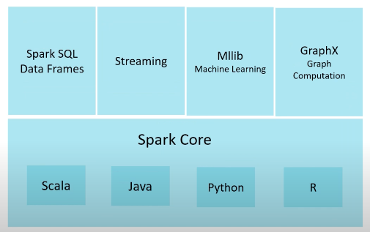
Apache Spark
Linear Programming – Transportation
Key Concepts:
Resilient Distributed Dataset (RDD): RDD is the fundamental data structure of Spark. It is an immutable distributed collection of objects that can be processed in parallel.
DataFrame & Dataset: These are higher-level abstractions over RDDs, introduced in Spark to support Spark SQL and structured data processing. They provide a more expressive and SQL-like API compared to RDDs.
Lazy Evaluation: One of the defining features of Spark. Computations are only executed when an action (like counting or saving to a file) is called, not when transformations (like map or filter) are defined. This allows Spark to optimize the execution plan.
Core Components:
Spark Core: Contains the basic functionality of Spark, including components for task scheduling, memory management, and fault recovery.
Spark SQL: Provides a programming interface for data structured as rows and columns (akin to a table in a relational database). It allows querying data via SQL as well as the Spark API.
Spark Streaming: Enables processing and analysing live data streams in real-time. Data can be ingested from various sources like Kafka, Flume, and more.
Spark MLlib: A distributed machine learning library with various algorithms for classification, regression, clustering, etc.
Spark GraphX: For graph computation, allowing processing of graph data structures and computation of standard graph algorithms.
Notes:
RDDs can be created from data stored in external storage systems or by transforming other RDDs.

Slide 17
Break
Linear Programming – Transportation
break (Staring at 4:05pm (AEDT))
Set Up your Jupyter We will do some coding to create a DataFrame with PySpark

Slide 18
Questions?

